Slide 1
Assessing bikeability of low-income tracts in California
Martin Liu, Giuseppe Perona

Slide 2
Motivation
AB 117: E-Bike Incentives Bill
Summary: E-Bike vouchers given to lower-income families
Passed Senate and Assembly
$10 million E-bike vouchers for ~10000 Californian households
Question to answer
Which places are most likely to take advantage of this voucher? (ie most bike-friendly)
How much additional infrastructure would these places need to be more bike-friendly?

Slide 3
Data
Cenpy
Census codes/data
Population density
Poverty
OSMNX
Networks
Different ways to collect various networks (eg. driving, walking, biking)
Generate graphs from a point and a radius (2km)
POI
Bike Infrastructure
Building types

Slide 4
Data Cleaning Process
1
2
3
4
Filter out by population density
Filter out by income level
Select 2km by 2km area
Filter out relevant POI and Network

Slide 5
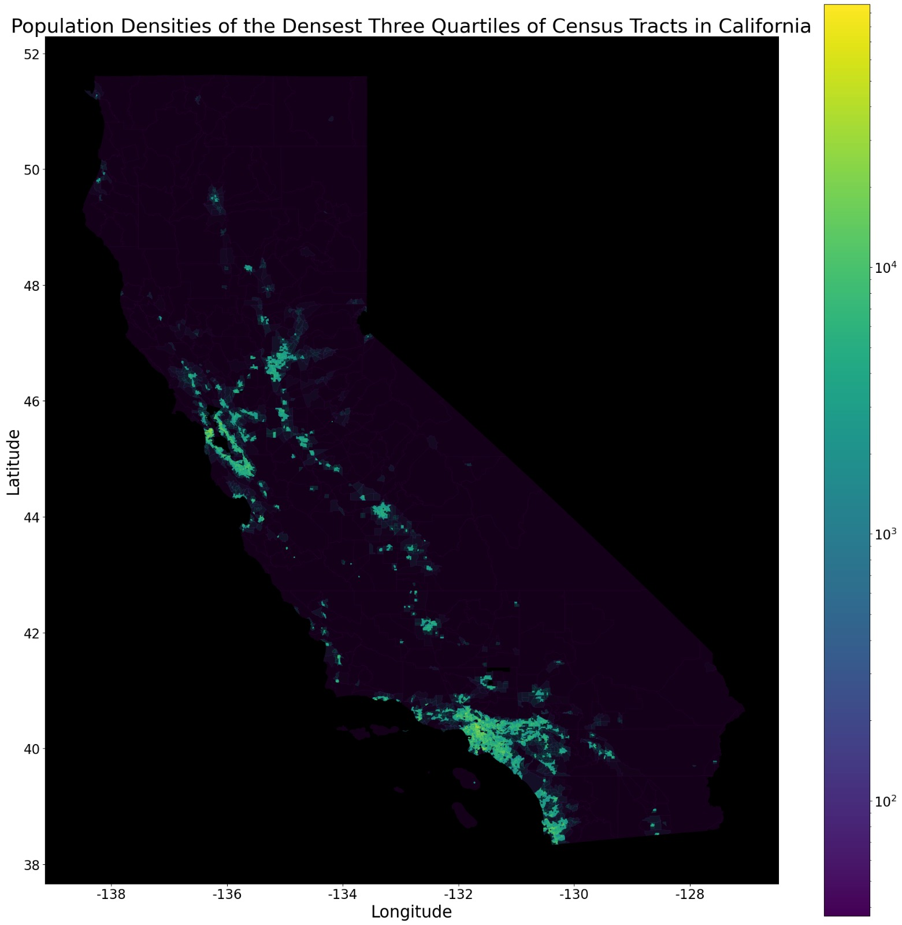
Data Cleaning: Density
Fig 1: Map of California, Population Density of Densest three quartiles

Slide 6
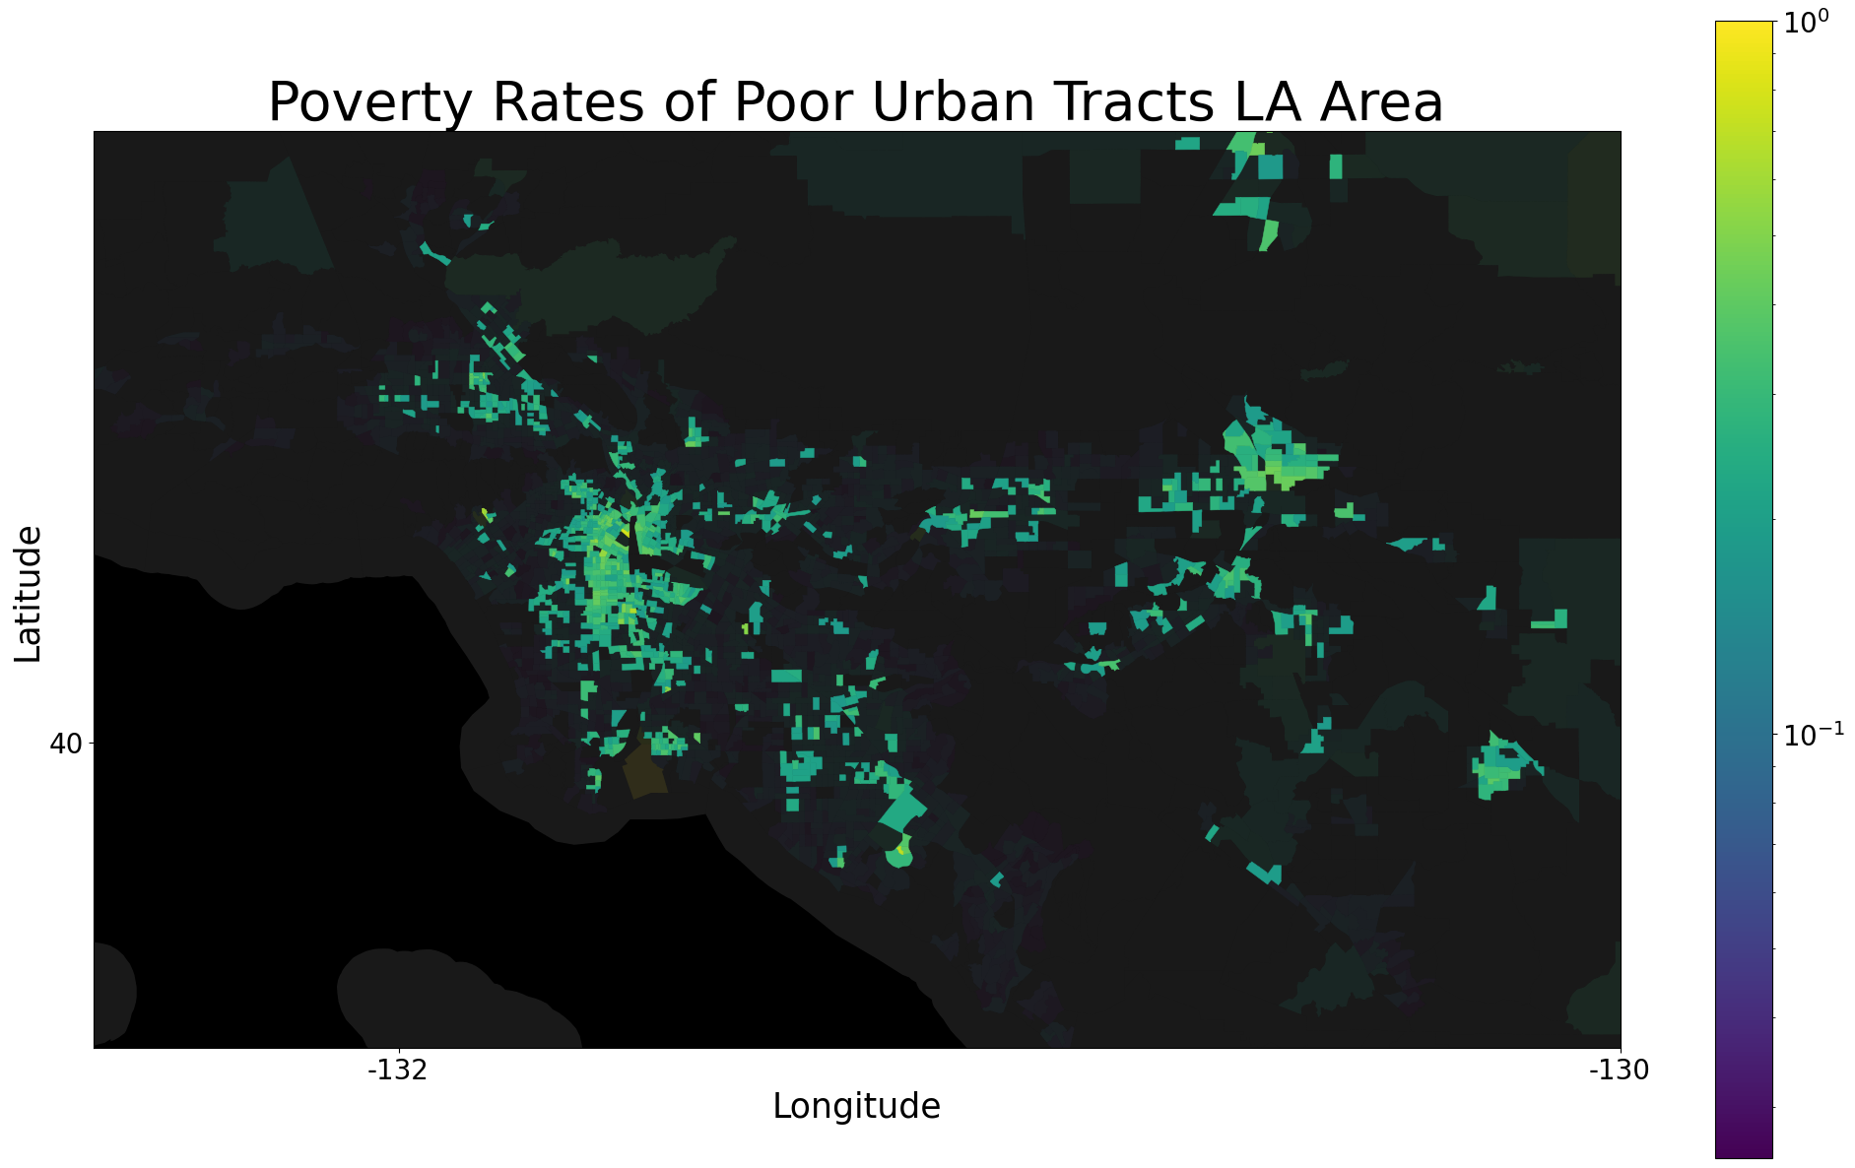
Data Cleaning: Poverty
Fig 2: Map of California, Poverty Rates of Poor Urban Tracts LA Area
Insert income map of LA and SF here
San Fernando Valley
San Bernardino
Downtown LA
Pacific Ocean

Slide 7
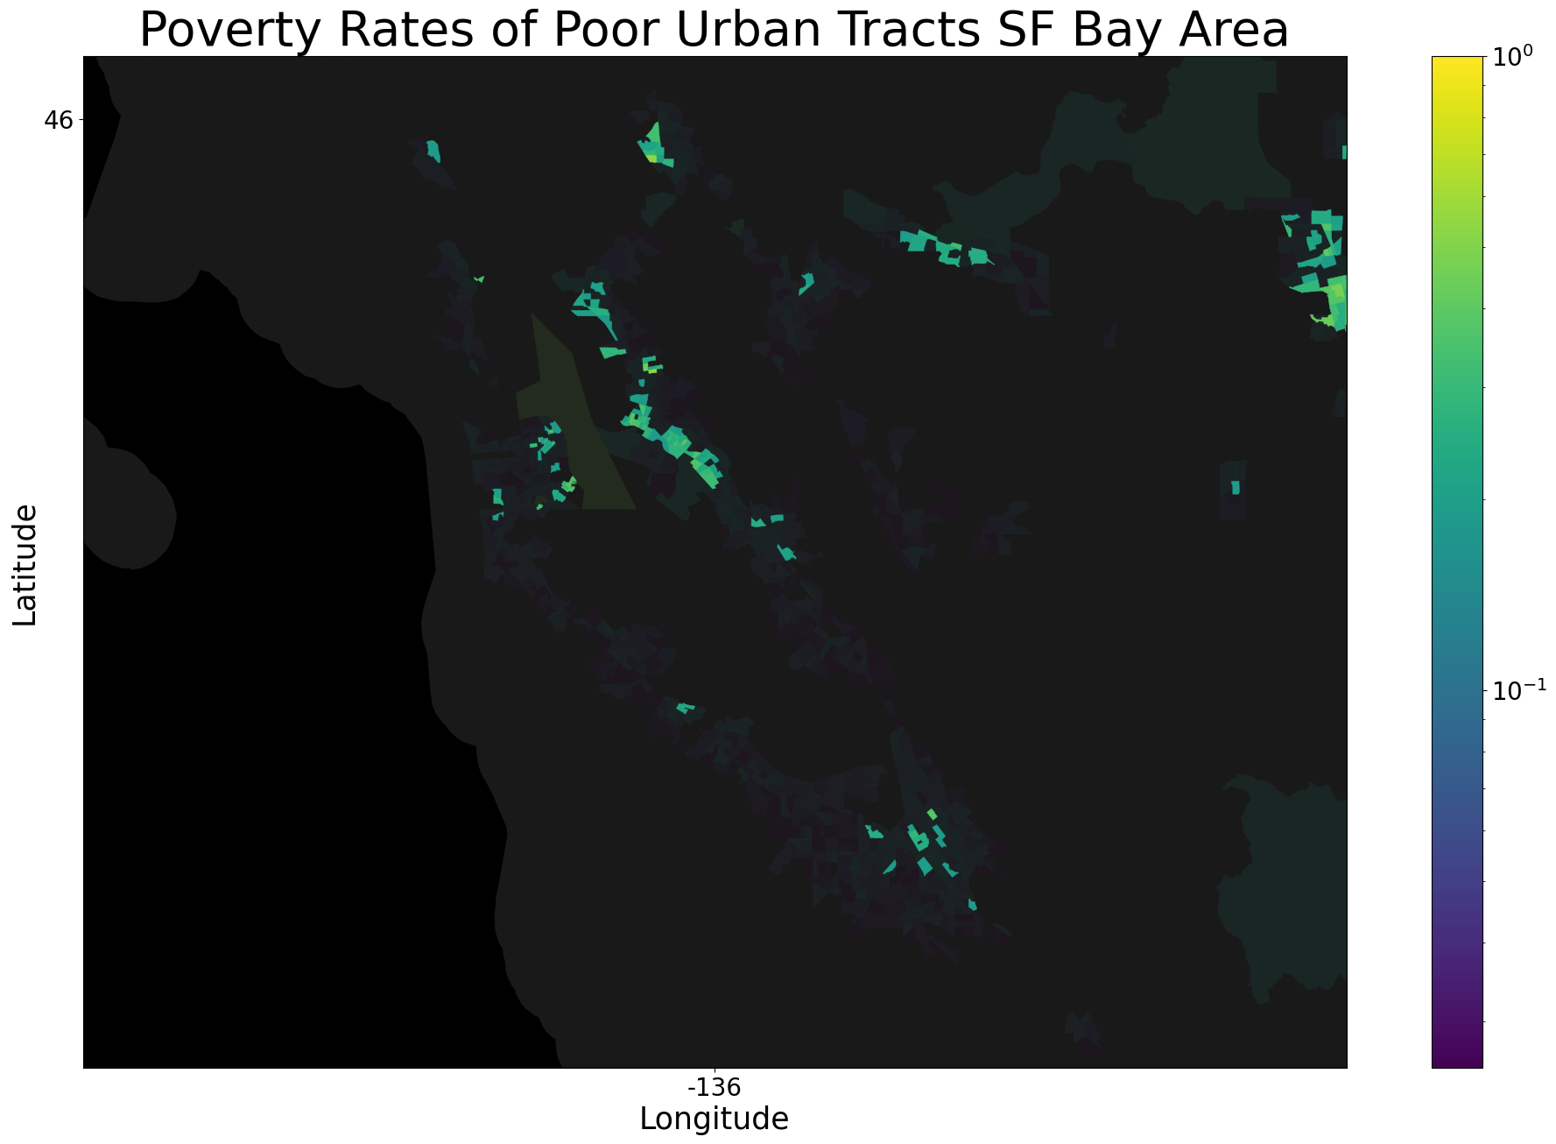
Data Cleaning: Poverty
Fig 2: Map of California, Poverty Rates of Poor Urban Tracts SF Bay Area
San Fernando Valley
San Fernando Valley
UC Berkeley!
San Bernardino
San Bernardino
San Francisco
Oakland
Downtown LA
Downtown LA
Pacific Ocean
Pacific Ocean
San Jose
Pacific Ocean

Slide 8
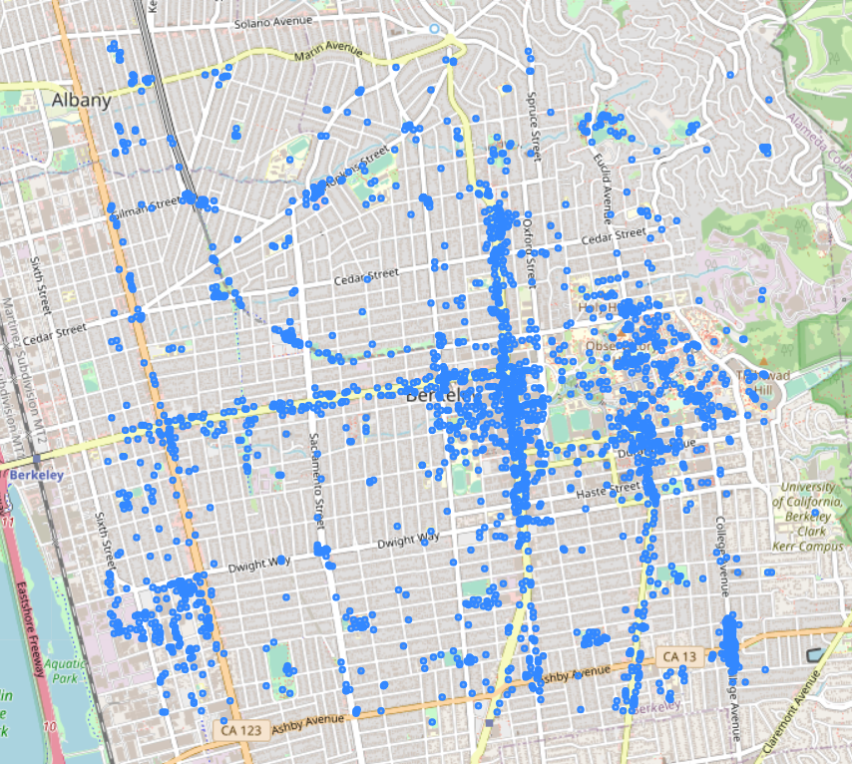
Data Cleaning: POI - Buildings & Amenities
Fig 4: Map of Berkeley, 2km bounded box, POIs

Slide 9
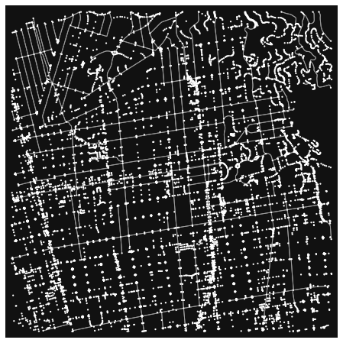
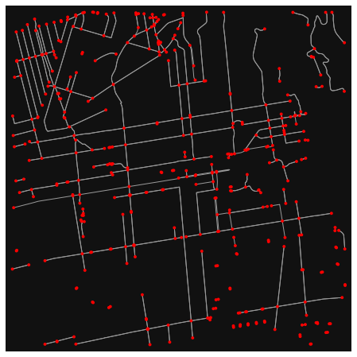
Data Cleaning: Networks - Bike Lanes
Fig 5: Map of Berkeley, 2km bounded box, all nodes and edges | Fig 6: Map of Berkeley, 2km bounded box, cycleway only nodes and edges
Notes:
Next we do data cleaning of the bike network
Figure X is a map of berkeley with a 2km bounded box and has all nodes and edges that osmnx classifies as bikes. This is essentially all roads
Figure X on the right is a map of berkeley with a 2km bounded box that have cycleways, which are those lanes on the side with a bike symbol on them.
We chose this as realistically those would be the lanes a cyclist would want to use.

Slide 10
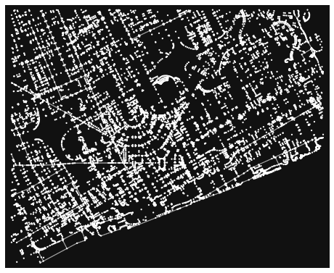
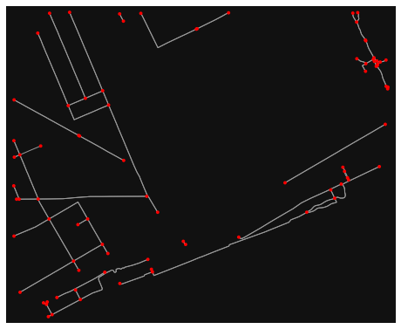
Ex. Detroit
Fig 7: Map of Detroit, 2km bounded box, all nodes and edges | Fig 8: Map of Detroit, 2km bounded box, cycleway only nodes and edges

Slide 11
Network Stats Definitions
low β suggests an increased chance that any given route requires leaving dedicated bike infrastructure to ride with mixed traffic
edges vs theoretical edges. Higher gamma values indicate greater internal connectivity and increased redundancy.
Number of times a node lies on the shortest path between other nodes.
β = edges / vertices
γ = e/ 3(v-2)
Max Betweenness

Slide 12
Network Statistics
 | Bike friendly cities | Non- bike friendly cities | Census tracts (sample size 50)
Bike node ratio | 1.95% | 0.59% | 0.75%
Bike edge ratio | 1.7% | 0.47% | 0.58%
Total edge length ratio | 13.5% | 6.11% | 5.74%
Degree | 3.13 | 2.97 | 2.83
Beta index | 1.56 | 1.48 | 1.41
Gamma index | 0.52 | 0.52 | 0.51
POI | 2287 | 417 | 159
Ratio w.r.t original bike network
Cycle-lane network only
Notes:
For the first three, these are ratio’ed with the original bike network
The logic behind this is that if the ratio is relatively low that implies that the city does have good infrastructure for commuting but alot of it is not meant for bikes, which is something that the city can improve on without building brand new roads.
In terms of the degree, beta, and gamma index we realized that the number are more or less the same regardless of the city. This might have to do with how the networks were made as we also tried this with original bike network but had similar results in the sense that they were indistinguishable from one another.
So at the very start we questioned how much infrastructure a city might need and while this is not the most accurate it could provide a quick and dirty was of assessing how bike-friendly a network is

Slide 13
Ex. Detroit
Fig 7: Map of Detroit, 2km bounded box, all nodes and edges | Fig 8: Map of Detroit, 2km bounded box, cycleway only nodes and edges

Slide 14
Network Statistics
 | Bike friendly cities | Non- bike friendly cities | Census tracts (sample size 50)
Bike node ratio | 1.95% | 0.59% | 0.75%
Bike edge ratio | 1.7% | 0.47% | 0.58%
Total edge length ratio | 13.5% | 6.11% | 5.74%
Degree | 3.13 | 2.97 | 2.83
Beta index | 1.56 | 1.48 | 1.41
Gamma index | 0.52 | 0.52 | 0.51
POI | 2287 | 417 | 159
Ratio w.r.t original bike network
Cycle-lane network only
Notes:
For the first three, these are ratio’ed with the original bike network
The logic behind this is that if the ratio is relatively low that implies that the city does have good infrastructure for commuting but alot of it is not meant for bikes, which is something that the city can improve on without building brand new roads.
In terms of the degree, beta, and gamma index we realized that the number are more or less the same regardless of the city. This might have to do with how the networks were made as we also tried this with original bike network but had similar results in the sense that they were indistinguishable from one another.
So at the very start we questioned how much infrastructure a city might need and while this is not the most accurate it could provide a quick and dirty was of assessing how bike-friendly a network is

Slide 15
Ranking Census tracts (sample)
Census Name | Bike nodes | Bike edges | Average degree | POIs | Betweenness
Census Tract 2949, LA | 190 | 456 | 4.8 | 62 | 6%
Census Tract 2655.10, LA | 175 | 346 | 3.95 | 770 | 8%
Census Tract 4623.01, LA | 129 | 264 | 4.09 | 416 | 9%
Census Tract 4020.01, LA | 117 | 185 | 3.162 | 188 | 3.5%
Census Tract 231.02, SF | 108 | 127 | 2.35 | 239 | .0.5%
Census Tract 1104, SC | 94 | 181 | 3.85 | 107 | 33%
Notes:
We took the top 6 bike nodes
Bottom line is that rather than going through all 2000 tracts, further analysis should be done by selecting areas with greater bike infrastructure.

Slide 16
Limitations
Moving Forward
Exact Locations
Bike Routing
Where to place bike infrastructure
Identify households that will benefit from the bill
OSM Data
Bike Safety
Wider range but less comprehensive than others
Develop a metric to determine safety of tracts

Slide 17
Policy
(backed by data!)

Slide 18
—Jan Gehl
“A city with a lot of bicyclists is indeed a city with a lot of life. A city with a lot of cars is a city with a lot of cars, metal, and speed. Not with people.

Slide 19
References
Boeing, G. 2017. OSMnx: New Methods for Acquiring, Constructing, Analyzing, and Visualizing Complex Street Networks. Computers, Environment and Urban Systems 65, 126-139. doi:10.1016/j.compenvurbsys.2017.05.004
https://anytimeestimate.com/research/most-bike-friendly-cities-us-2022/
https://wiki.openstreetmap.org/wiki/Main_Page
Schoner, J.E., Levinson, D.M. The missing link: bicycle infrastructure networks and ridership in 74 US cities. Transportation 41, 1187–1204 (2014). https://doi.org/10.1007/s11116-014-9538-1
Winters, M., Brauer, M., Setton, E. M., & Teschke, K. (2013). Mapping Bikeability: A Spatial Tool to Support Sustainable Travel. Environment and Planning B: Planning and Design, 40(5), 865–883. https://doi.org/10.1068/b38185
Jackson Herron’s notebook

Slide 20
Bicycle icon pack

